Slide 1
Introduction to ADF Business Components
(Section 2)

Slide 2
Business service layer
Business logic for an application resides in the area between the UI layer and datasource, fulfilling the requests from the client by interacting with the datasource or other third-party services.
A well designed application may have multiple layered structures for business service implementation, where each layer plays a unique role. Take a quick look at the various layers:
Service layer
Business logic layer
Data access layer
Service
Layer
Business
Logic
Data
Access
Layer
Data
Source

Slide 3
Why ADF Business Components?
Business service implementation involves the following three major tasks:
Building business logic for the application
Building generic infrastructure services such as connecting to a database, transaction management, business data audit, validation, security, and product customization
Exposing the services through multiple channels such as EJB, web service, or plain Java to be used by various clients
Oracle Adf provides the generic infrastructure services , it may free the developers to focus on business logic implementation, eliminating the complexity of the underlying technology.
The ADF framework uses the configurations stored in metadata XML definition files for instantiating appropriate business components. If you want to override the default behavior of the business components then you can generate Java implementation for the desired business components .

Slide 4
Oracle ADF Business Components' feature list
Oracle ADF Business Components provides a visual and declarative development experience.
built using Object Relational Mapping (ORM) concepts.
Design-time support for exposing business service implementation as web services with very minimal or zero coding.
Layered architecture of business components.
Built-in support for managing database connection and middle tier transaction.
Building model driven UI components. The framework builds UI components on the fly by using UI hints.
Declaratively master and details collection.
Infrastructure services such as paginated queries, validation, security, concurrency management through locking, and business data auditing.

Slide 5
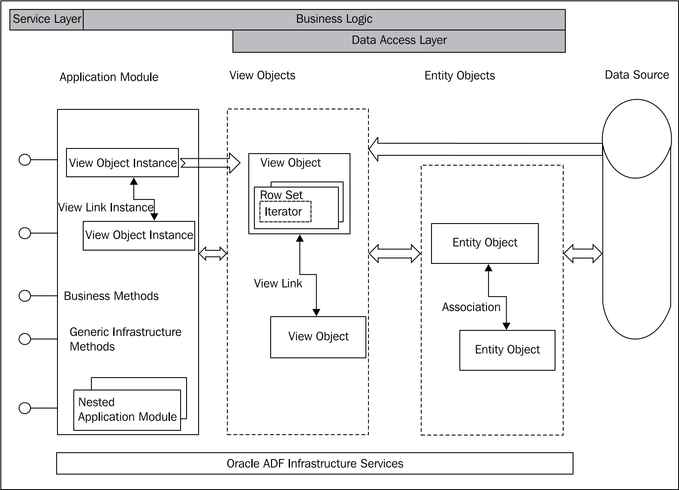
Core building blocks

Slide 6
Core building blocks
Entity objects (definition XML metadata file - Entity definition -Java Entity object - Entity collection)
Entity Collections
Associations
View objects (definition XML metadata file, View object definition, Java View object, Java View row)
View links
Row sets
Query collections

Slide 7
Core building blocks
Application modules (definition XML metadata file , Application module definition , Java Application module)
View object instances
View link instances
Custom business methods
Nested application module
Services and service data objects

Slide 8
Familiar Concepts for Oracle Forms Developers
ADF Business Components implements all of the data-centric aspects of the familiar Oracle Forms runtime functionality, but in a way that is independent of the user interface. In Oracle Forms, each form contains both visual objects as well as nonvisual.
Similarities between the Application Module and a "Headless" Form Module
The application module component is the "data portion" of the form
Similarities between the Entity Object and a Forms Record Manager
In the Forms runtime the record manager is responsible for keeping track of which of the rows in the data block have changed
Similarities between the View Object and a Data Block
The View Object component performs the "data retrieval" portion of the data block functionality

Slide 9

Building a simple business service
These are the configuration files under discussion
The bc4j.xcfg file contains metadata information about the application module
The adf-config.xml file contains application-level settings for various framework components across layers of the application
The <ModelProjectName>.jpx file is used by both design-time editors and runtime framework components
The adfm.xml file contains path information for other registry files used in the model project

Slide 10
Oracle ADF Model Tester
The JDeveloper comes with a Graphical User Interface (GUI) based Model Tester to test your business components.

Slide 11
Java test client for ADF Business Components
public class TestClient {
public static void main(String[] args) {
String amDef = "com.packtpub.adfguide.ch2.model.service.HRServiceAppModule";
String config = "HRServiceAppModuleLocal";
ApplicationModule am = Configuration.createRootApplicationModule(amDef, config);
// Work with your appmodule and view object here
//Find Department View Object Instance
ViewObject vo = am.findViewObject("Departments");
//Execute Department query
vo.executeQuery();
//Fetch the first record
Row deptRow = vo.first();
//DO SOMETHING WITH FETCHED ROW.
// Clean up resources
Configuration.releaseRootApplicationModule(am, true);
}
}

